Slide 1

INFORMATION SYSTEMS SPRING ’20
Data Science Engineering Methods and Tools
INFO 06105 – 37555
“Prediction Analysis of Interest Rate Using Machine Learning”
Implemented By:
Akash Dubey
Jayshil Jain
Priyanka Malpekar
Siddhi Prabhu
Tanvi Gurav
Guided By : Prof. Handan Liu
TA: Vikas Kumar, Mingyu Liu

Slide 2
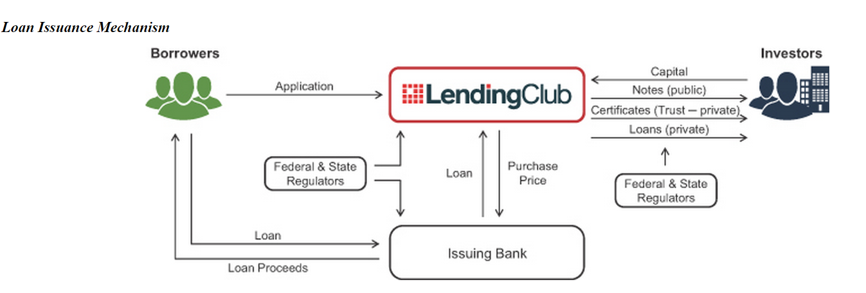
INTRODUCTION
Lending Club offers loans of various grades they assign that correspond to specific interest rates for investors
It is a peer-to-peer lending company, the largest of its kind in the world. It aims to operate a platform at low cost to offer interest rates to our borrower members lower than the rates they could obtain through credit cards or traditional banks
The risk comes in the form of defaults - whenever a loan defaults, investors end up losing a portion of their investment
On the basis of the borrower’s credit score, credit history, desired loan amount and the borrower’s debt-to-income ratio, Lending Club determines whether the borrower is credit worthy and assigns to its approved loans a credit grade that determines payable interest rate and fees

Slide 3

OVERVIEW
Lending Club is a US peer-to-peer lending company.
The company asserted that $15.98 billion in loans had been arising through its platform up to December 31,2015
The Lending Club enables borrowers to possess unsecured personal loans between the range of $1,000 and $40,000
The standard loan period is of three years. Thereby, all the Investors can search and find the listing of loans on the website of Lending Club and therefore choose loans that they wish to invest in based on the information supplied about the borrower, the amount, grade, and the purpose of the loan
Investors make money from the interests
Lending Club makes a profit by charging the borrowers a fee called the origination fee and for investors a service fee

Slide 4
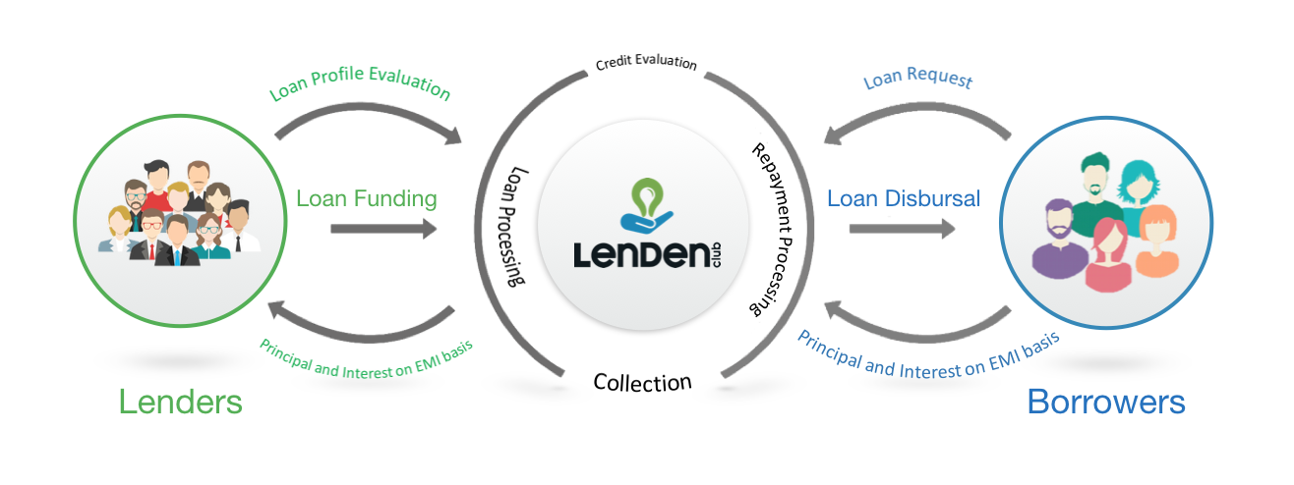
OBJECTIVES
To work on loan predictions using machine learning models and provide a model that caters their needs
To provide a full funded loan from lending club to clients
To predict the lowest possible interest rates
To avoid loans that are predicted to default
To get a desired loan duration
To provide an online lending platform where borrowers are able to obtain loans and investors can purchase notes backed by payments based on loans
To predict the expected returns for loans to a given borrower
To maximize our returns by predicting the probability of default of the borrower so as to help avoid investment in those high-risk notes

Slide 5
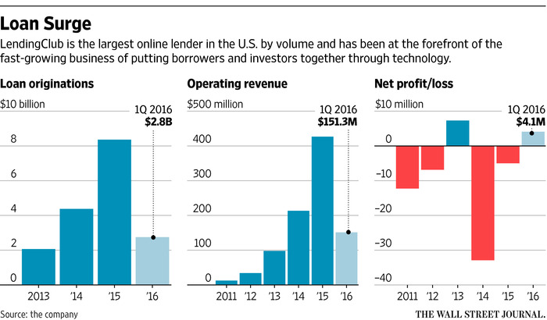
MOTIVATION
With the rising popularity of peer-to-peer lending platforms in recent years, investors now have easy access to this alternative investment asset class by lending money to individual borrowers through platforms such as Lending Club, Prosper Marketplace, and Upstart, or to small businesses through Funding Circle
Hence, it is desirable for investors to be able to independently evaluate the credit risk of a large number of listed loans quickly, and invest in those with lower perceived risks
This motivates us to build machine-learned classification and regression models that can quantify the credit risk with a Lending Club historical loan dataset

Slide 6
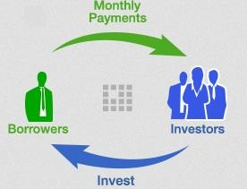
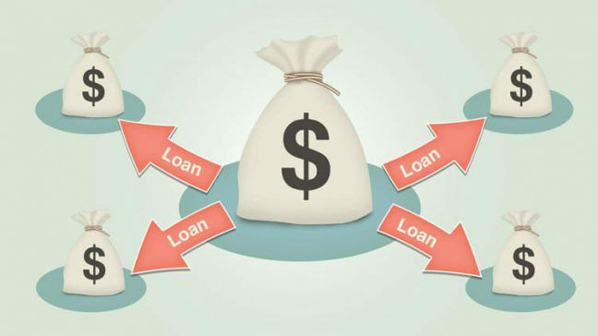
RELATED WORK
Prior projects like "Predicting borrowers chance of defaulting on credit loans" have set great examples of applying machine learning to improve loan default prediction in a Kaggle competition, and authors for "Predicting Probability of Loan Default" have shown that Random Forest appeared to be the best performing model on the Kaggle data
However, despite of the early success using Random Forest for default prediction, real-world records often behaves differently from curated data, and a later study "Peer Lending Risk Predictor" presented that a modified Logistic Regression model could outperform SVM, Naive Bayes, and even Random Forest on Lending Club data
The fact that Logistic Regression performance could be immensely improved by simply adding penalty factor on misclassification gave rise to our interest in fine tuning other not-yet optimized models, in particular, SVM and Naive Bayes, to continue the search for a better predictive model in the realm of loan default

Slide 7

DATASET OVERVIEW
(A) DATA SOURCE
https://www.kaggle.com/wendykan/lending-club-loan-data
(B) SPECIFICATION OF DATA SET
We have 74 columns of data out of which 20 are Categorical Variables and 54 are Numeric Variables
38 of 74 columns allow NULL values
These files contain the latest payment information and all the necessary and appropriate loan data for all the loans issued through 2001-2015 which also includes current loan status (Current, Fully Paid, Late, etc.)
The file containing loan data through the "present" contains complete loan data for all loans which are issued through the previous completed calendar quarter
There are certain additional features that include credit scores, address including zip codes and state, number of finance inquiries and various other collections
The file is a matrix that includes a total of 75 variables and about 890 thousand observations. Also, a data dictionary is placed in a different file

Slide 8
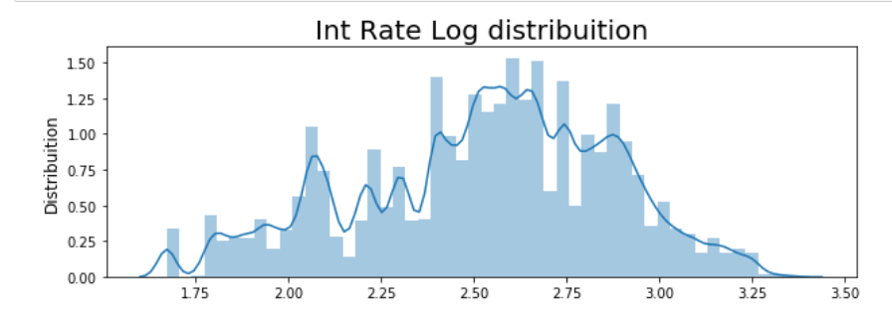
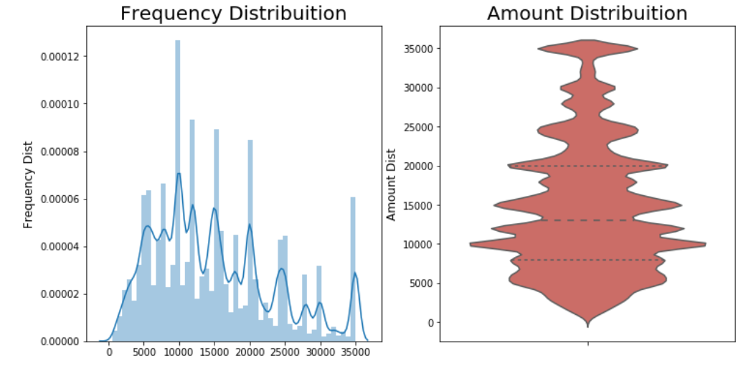
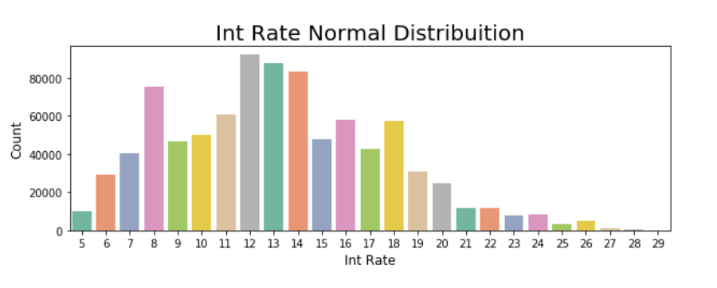
DATA ANALYSIS

Slide 9
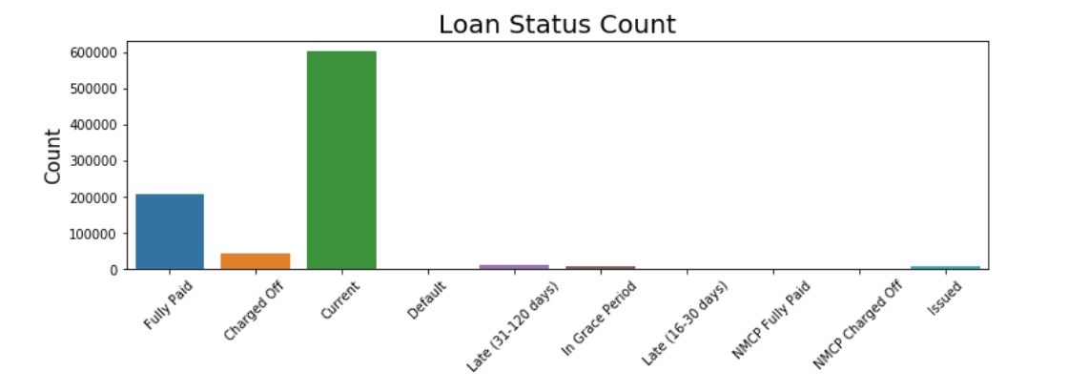
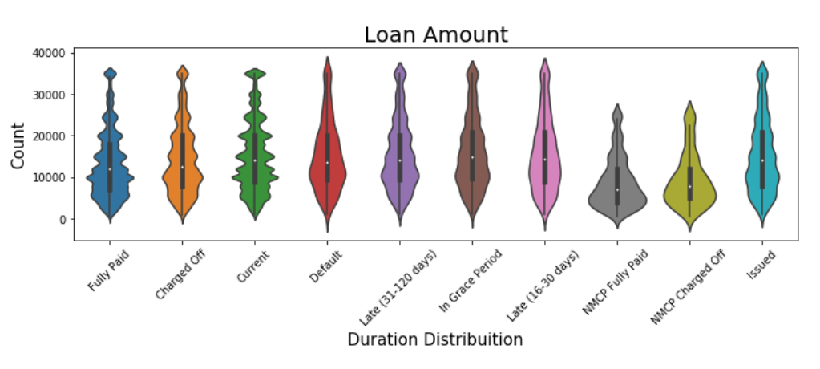
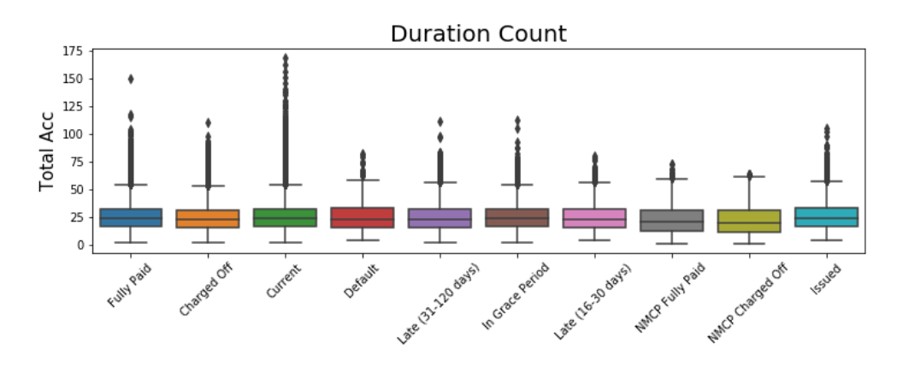
Understanding the Data

Slide 10
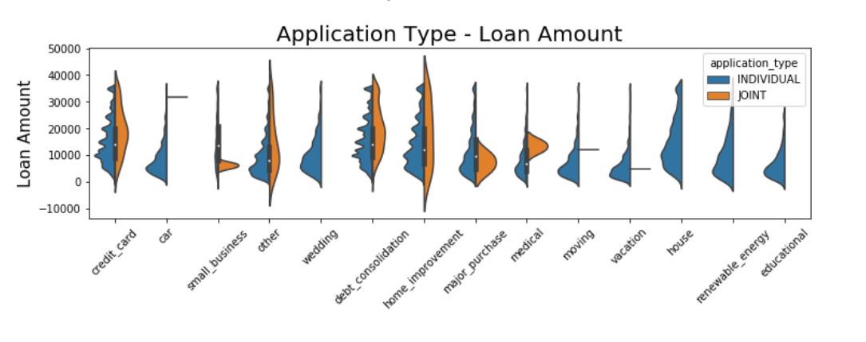
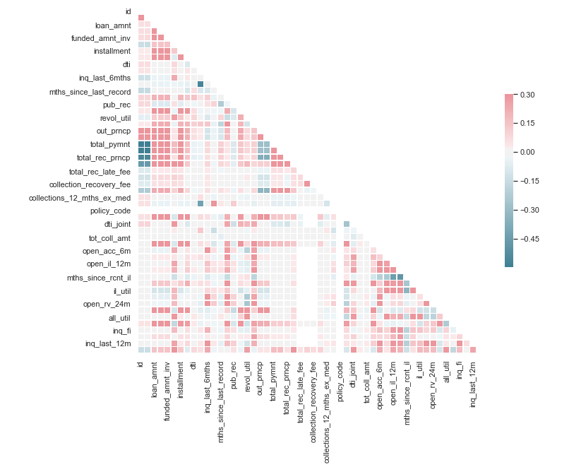
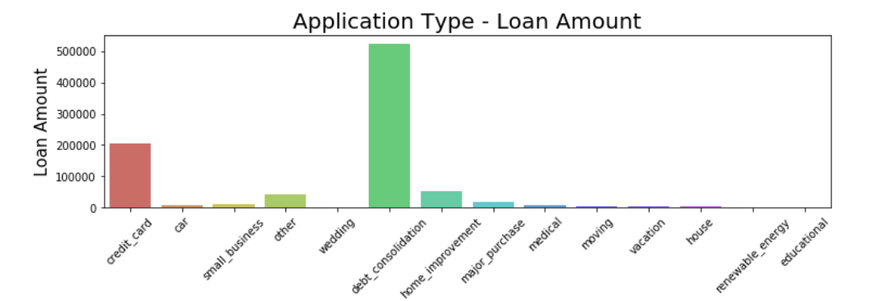
Correlation Analysis

Slide 11
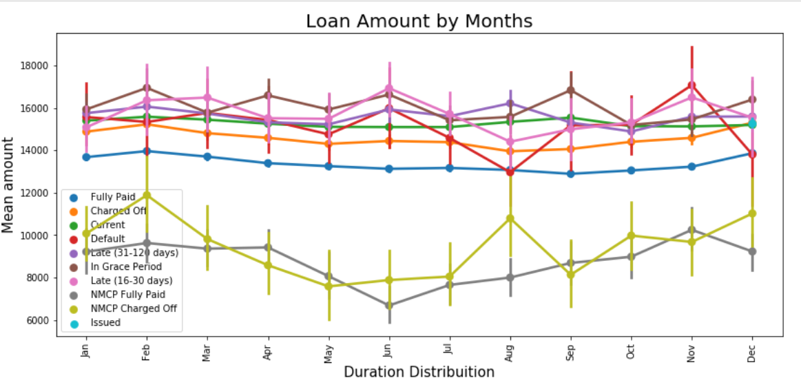
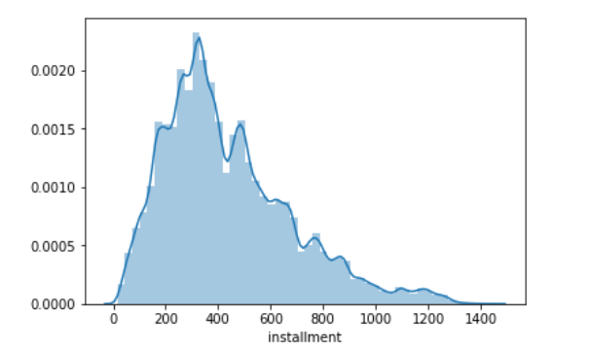
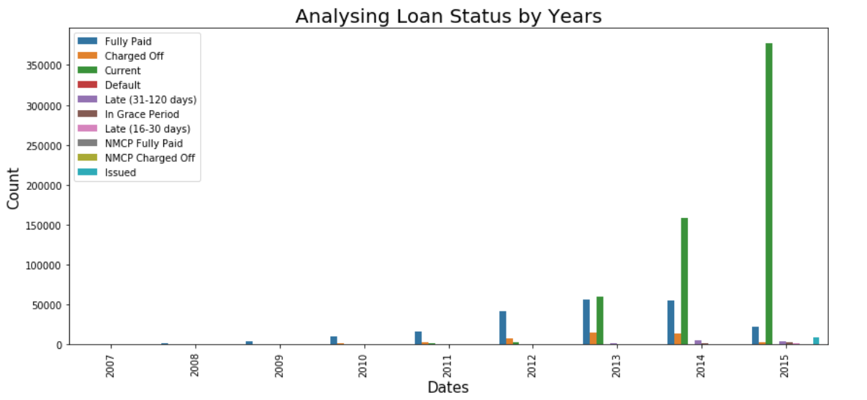
Understanding the installment column

Slide 12
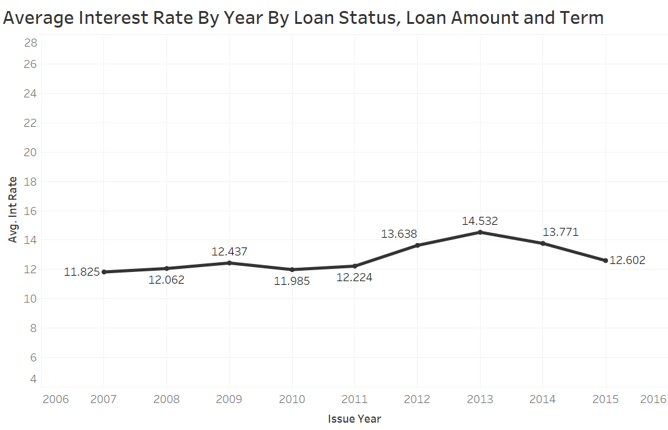
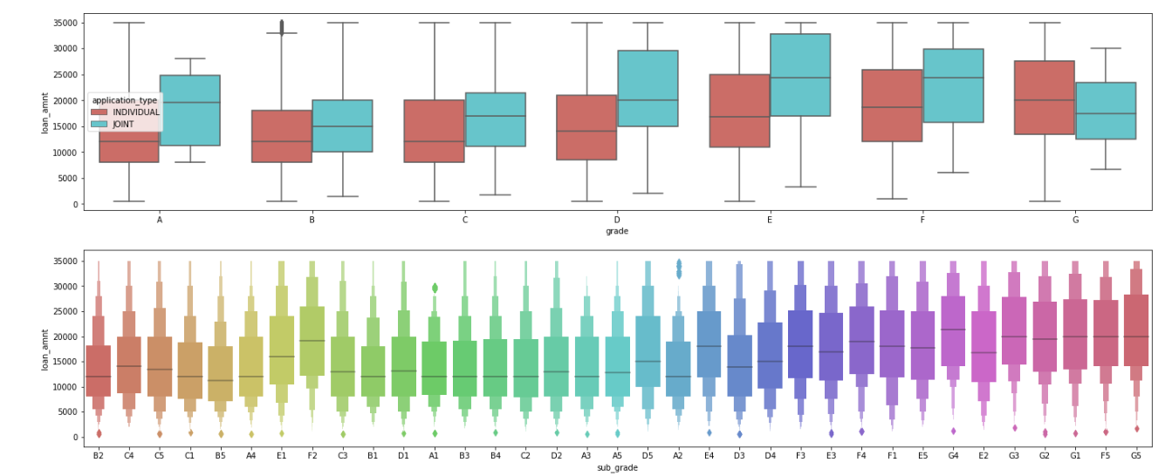
Looking at Grades

Slide 13
METHODOLOGY
Evaluating Data | Count
Total Row Count | 66553425
Total Missing Values in Dataset | 17998490
Total Percentage = (missing_values/total_values)*100 Hence, the total percentage of missing values in dataset is 27.043672057448582
CLEANSING AND PREPROCESSING
FEATURE SELECTION

Slide 14

Cleansing and Pre-processing
A ) Importing the Data and removing unnecessary columns
Columns with empty values for most of the rows as well as columns with the same values across all rows are dropped in order to have a cleaner dataset
Further, we have dropped unnecessary columns which are not required in order to make a more cleaner dataset
We have taken the sum of the missing values in the dataset and divided it with the total values. After which, we have calculated the total percentage of missing values in the data as per the total values
We then created more cleaner data by dropping all the columns which have missing values more than 50%
Also, we have eliminated all the target values in the dataset which has no relation with the target variable

Slide 15
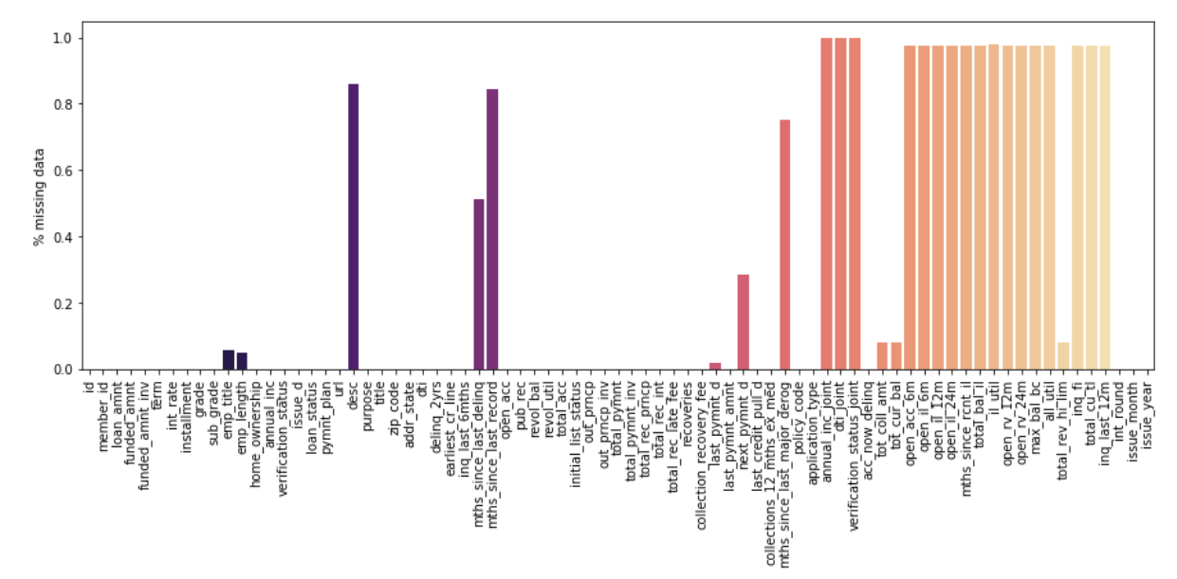
B) Implementing Mice to fill missing values MICE – Multiple Imputation by Chained Equations
Missing data is predicted by observed data, using a sequential algorithm that is allowed to proceed to convergence
(1) We have started filling in the missing data with plausible guesses at what the values might be
(2) For each variable, we have predicted the missing values by modeling the observed values as a function of the other variables
At each step, we have updated the predictions of the missing values
Further, we have calculated stats model imputation formulas and updated the values available in the specified range
Looking at the missing values

Slide 16
C) Normalizing Data With Sklearn.ipynb
Correlation Analysis
We then have approached to perform Normalization on the dataset to bring the data set on the same scale
We have splitted the dataset into 2 data frames out of which 1 needs to be normalized
Later, we performed normalization and then summarized the transformed data
We have then calculated the correlation with interest rate after normalization for performing analysis and visualizations

Slide 17
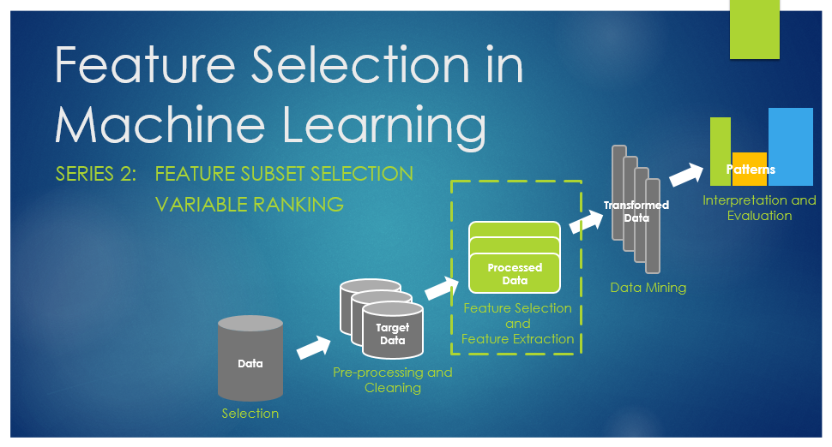
Feature Selection
Feature engineering is the process of using domain knowledge of the data to create features that make machine learning algorithms work
If feature engineering is done correctly, it increases the predictive power of machine learning algorithms by creating features from raw data that help facilitate the machine learning process
Notes:
What is a feature and why we need the engineering of it? Basically, all machine learning algorithms use some input data to create outputs. This input data comprise features, which are usually in the form of structured columns. Algorithms require features with some specific characteristics to work properly. Here, the need for feature engineering arises. feature engineering efforts mainly have two goals: Preparing the proper input dataset, compatible with the machine learning algorithm requirements and thereby improving the prediction power of machine learning models.
The features you use influence more than everything else the result. No algorithm alone, to my knowledge, can supplement the information gain given by correct feature engineering. According to a survey in Forbes, data scientists spend 80% of their time on data preparation.
We have implemented Feature Selection in two parts:
1. Implementing Lasso CV for feature Selection
2. Implementing Feature Tools

Slide 18
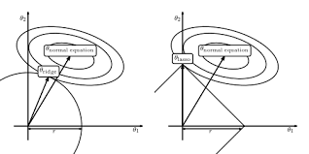
A) Implementing Lasso CV for feature Selection
Lasso (“Least Absolute shrinkage and selection operator”) is a regression analysis method that performs both variable selection and regularization in order to enhance the prediction accuracy and interpretability of the statistical model it produces
The data is then categorized into three sets and treated differently: train, test and cv
We then splitted the data into dependent and independent variables to perform lasso cv for variable selection
Notes:
LASSO which stands for "Least Absolute shrinkage and selection operator" regression analysis is a shrinkage and variable selection method for linear regression models. Our goal here is to obtain the subset of predictors that minimizes prediction error for a quantitative response variable. The lasso does this by imposing a constraint on the model parameters that cause regression coefficients for some variables to shrink toward zero. Variables with a regression coefficient equal to zero after the shrinkage process are excluded from the model. Variables with non-zero regression coefficients variables are most strongly associated with the response variable.
- We start with spliting the data in train ,test , cv
- Then, split the data into dependent and independent variables
- Further, we performed Regression Analysis for variable selection and regularization
in order to enhance the prediction accuracy and interpretability of the statistical model
alphas: List of alphas where to compute the models
predict: Predict using the linear model
coef: Parameter vector
Root Mean Square Error (RMSE) of Lasso: 0.21048880904060138

Slide 19
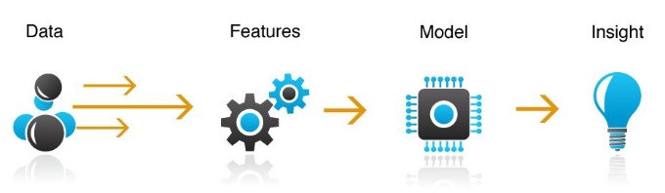
B) Implementing Feature Tools
Feature tool helps the user to find some features that are necessary for mathematical calculation like avg, min, max, count etc
Feature tools have a lot of limitations like you need to pass proper entities before gaining features out of it
Feature tool works well only with the numeric data
A user needs to decide manually first what features he needs and then pass the primitives accordingly
Notes:
Featuretools is an open-source Python library for automated feature engineering. Featuretools, automated feature engineering which to create thousands of relevant features from a set of related data tables. All we need to know is the basic structure of our tables and the relationships between them which we track in a single data structure called an entity set. Once we have an entity set, using a method called Deep Feature Synthesis (DFS), we’re able to build thousands of features in one function call. DFS works using functions called “primitives” to aggregate and transform our data. We implemented featuretools on following five features:
issue_d, grade, sub_grade, term, addr_state
- We started with making an entityset and add the entity
- List all the avaliable primitives
- Run deep feature synthesis with transformation primitives
- Lastly, put feature matrix in feature_gained csv

Slide 20
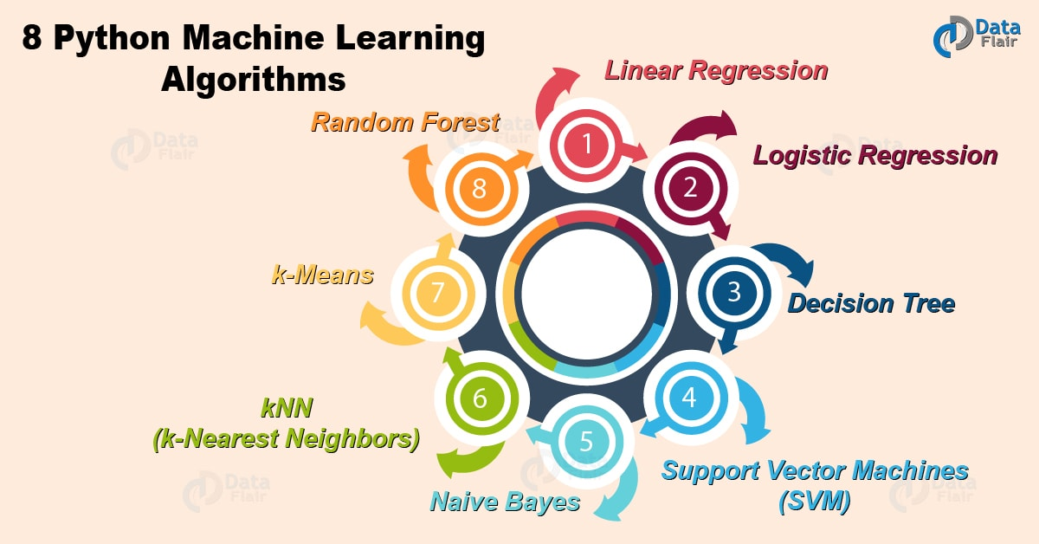
Models and Algorithms used
Auto-Sklearn
H2O AI
Linear Regression
Neural Networks
Random Forests
Tpot

Slide 21
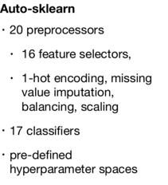
Auto-Sklearn
Auto-SKLearn automatically searches for the right machine learning algorithm for a new machine learning dataset and optimizes its parameters
It is an open source, implemented in python and built around the scikit-learn library
It contains a machine learning pipeline which takes care of missing values, categorical features, sparse and dense data, and rescaling the data
Libraries required:
import autosklearn.classification
class = autosklearn.classification.AutoSklearnClassifier()
class.fit(X_train, y_train)
prediction = class.predict(X_test)

Slide 22
Creating training and test datasets
X_train, X_test, y_train, y_test = sklearn.model_selection.train_test_split(fullData[features], fullData[target_col],test_size=0.20, random_state=42)
Performing regression on the training dataset
autoskml = autosklearn.regression.AutoSklearnRegressor()
autoskml.fit(X_train, y_train)
The predict function calls the predict function of the underlying scikit-learn model and returns an array with the predictions
prediction = autoskml.predict(X_test)
autoskml.fit(X_train, y_train)
y_hat_test = autoskml.predict(X_test)
x_hat_train = autoskml.predict(X_train)

Slide 23
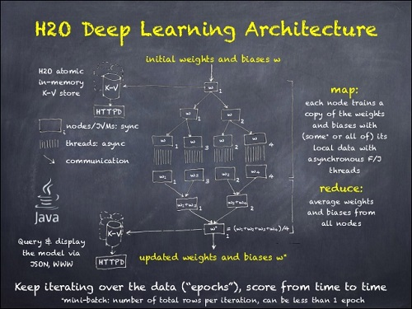
H2O AI ( Hyper Parameter Optimization)
The H2O Python Module is a tool for rapidly turning over models, doing data munging, and building applications in a fast, scalable environment without any of the mental anguish about parallelism and distribution of work
In random forests, a random subset of candidate features is used to determine the most discriminative thresholds that are picked as the splitting rule. In extremely randomized trees (XRT), randomness goes one step further in the way that splits are computed
H2O supports extremely randomized trees (XRT) via histogram_type="Random"
When this is specified, the algorithm will sample N-1 points from min…max and use the sorted list of those to find the best split. The cut points are random rather than uniform
Notes:
H2O
H2O is a fully open source, distributed in-memory machine learning platform with linear scalability. H2O supports the most widely used statistical & machine learning algorithms including gradient boosted machines, generalized linear models, deep learning and more. H2O also has an industry leading AutoML functionality that automatically runs through all the algorithms and their hyperparameters to produce a leaderboard of the best models.

Slide 24
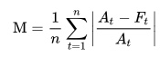
Hypertuning: A model hyperparameter is a configuration that is external to the model and whose value cannot be estimated from data. They are often used in processes to help estimate model parameters. They are often tuned for a given predictive modeling problem.
Libraries and Packages to be imported
import sys
import h2o
from h2o.estimators.random_forest import H2ORandomForestEstimator
from h2o.estimators.glm import H2OGeneralizedLinearEstimator
from h2o.grid.grid_search import H2OGridSearch
from h2o.estimators.deeplearning import H2ODeepLearningEstimator
Import and start H2O on same machine as running python process
import h2o
h2o.init()
Calculate MAPE (Mean absolute percentage error) value
The mean absolute percentage error (MAPE) is a statistical measure of how accurate a forecast system is. It measures this accuracy as a percentage and can be calculated as the average absolute percent error for each time period minus actual values divided by actual values. Where At is the actual value and Ft is the forecast value, this is given by:
Notes:
Calculate MAPE (Mean absolute percentage error) value
The mean absolute percentage error (MAPE) is a statistical measure of how accurate a forecast system is. It measures this accuracy as a percentage and can be calculated as the average absolute percent error for each time period minus actual values divided by actual values.
- Start H2O on same machine as running python process (h2o.init())
- Importing the mixed dataset
- Generate training and testing datasets
- Defining Response and Predictors
The outcome variable is also called the response or dependent variable, and the risk factors and confounders are called the predictors, or explanatory or independent variables. In regression analysis, the dependent variable is denoted "Y" and the independent variables are denoted by "X".
We use the following H2o models which
1. Using H2ORandomForestEstimator(): Builds a Distributed Random Forest (DRF) on a parsed dataset, for regression or classification
2. Using H2OGeneralizedLinearEstimator(): Fits a generalized linear model, specified by a response variable, a set of predictors, and a description of the error distribution.
3. Using H2ODeepLearningEstimator(): Build a Deep Neural Network model using CPUs Builds a feed-forward multilayer artificial neural network on an H2OFrame

Slide 25
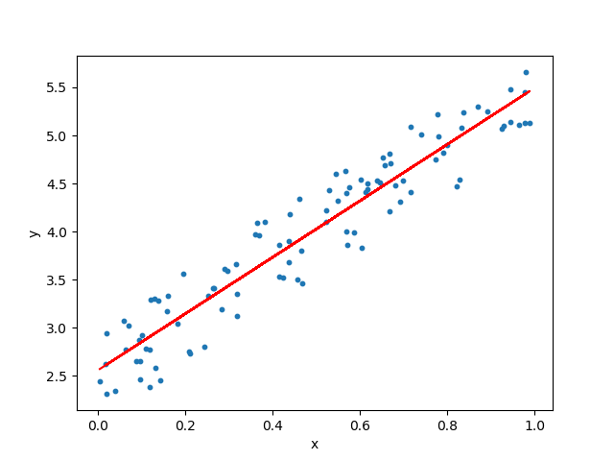
Linear Regression
Linear regression is a statistical approach for modelling the relationship between a dependent variable with a given set of independent variables
Linear regression technique finds out a linear relationship between x (input) and y (output). It is used to predict a quantitative response Y from the predictor variable X. It is made with an assumption that there's a linear relationship between X and Y
The equation of the above line is :
Y= mx + b
Where b is the intercept and m is the slope of the line
Linear regression algorithm gives us the most optimal value for the intercept and the slope (in two dimensions)
The y and x variables remain the same, since they are the data features and cannot be changed. The values that we can control are the intercept(b) and slope(m)

Slide 26
Parameters Used
Y = int_rate
X = grade_C,grade_D,grade_E, grade_F,grade_G,total_rec_int, total_pymnt_inv,funded_amnt_inv, sub_grade_B5, sub_grade_B4,sub_grade_C5, sub_grade_C4,sub_grade_C3,sub_grade_B4,sub_grade_D5
Alpha = 1
Significance of Parameters
Y (Target Variable) = Y is a required variable. We specify the column to use as the dependent variable
For a regression model, this column must be numeric (Real or Int). We have used int_rate as a target variable because we have based all our evaluation and modelling with respect to interest rate
X (Predictor Variable) = X is also a required variable. We specify the names of the columns on which the target variable depends
These are called independent variables.
We have used grade_C, grade_D, grade_E, grade_F, grade_G, total_rec_int, total_pymnt_inv,funded_amnt_inv,sub_grade_B5, sub_grade_B4,sub_grade_C5, sub_grade_C4,sub_grade_C3,sub_grade_B4,sub_grade_D5 as our predictor variable as after using feature selection tools like lasso cross validation we came to a conclusion that these are the best predictors
Alpha = 1
The alpha parameter controls the distribution between the ℓ1ℓ1 (LASSO) and ℓ2ℓ2 (ridge regression) penalties. The penalty is defined as:
P(α,β)=(1−α)/2||β||22+α||β||1=∑j[(1−α)/2β2j+α|βj|]
🡪 a value of 1.0 represents LASSO, and a value of 0.0 produces ridge regression.

Slide 27
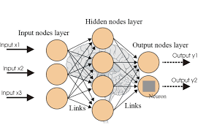
Neural Networks
Neural Networks are a class of models within the general machine learning literature. They are a specific set of algorithms that have revolutionized machine learning
They are inspired by biological neural networks and the current so-called deep neural networks have proven to work quite well
Neural network tries to minimize the squared loss on the training set

Slide 28
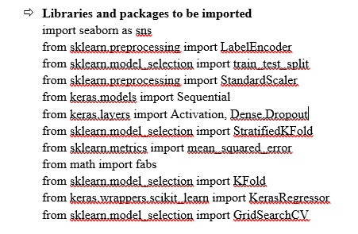
Significant Parameters used
Y = int_rate
X = grade_C,grade_D,grade_E,grade_F,grade_G, total_rec_int, total_pymnt_inv, funded_amnt_inv, sub_grade_B5, sub_grade_B4,sub_grade_C5, sub_grade_C4,sub_grade_C3,sub_grade_B4,sub_grade_D5
Optimizers: Gradient descent is an iterative machine learning optimization algorithm to reduce the cost function. Here we have used GCD
Epochs: Specify the number of times to iterate (stream) the dataset. The value can be a fraction. In our case it is 15
Hidden: Specify the hidden layer sizes (e.g., 100,100). The value must be positive
Mini_batch_size: Specify a value for the mini-batch size. (Smaller values lead to a better fit; larger values can speed up and generalize better) which is 10
Activation: Specify the activation function (Tanh, Tanh with dropout, Rectifier, Rectifier with dropout, Maxout, Maxout with dropout). Here, we used RELU (Rectified Linear Unit)
Impute numerical missing values with mean
fullData[num_cols] = fullData[num_cols].fillna(fullData[num_cols].mean())
Impute categorical missing values with -9999
fullData[cat_cols] = fullData[cat_cols].fillna(value = -9999)

Slide 29
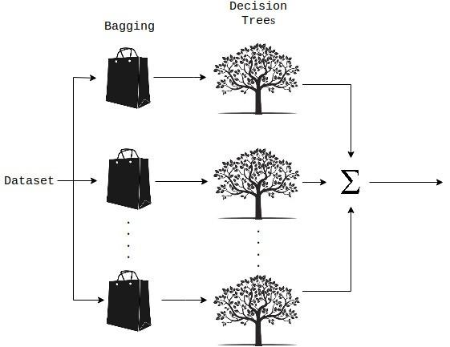
Random Forests
A Random Forest is an ensemble technique capable of performing both regression and classification tasks with the use of multiple decision trees
The random forest algorithm combines multiple algorithms of the same type i.e. multiple decision trees, resulting in a forest of trees, hence the name "Random Forest". The random forest algorithm can be used for both regression and classification tasks
In case of a regression problem, for a new record, each tree in the forest predicts a value for Y (output). The final value can be calculated by taking the average of all the values predicted by all the trees in forest. Or, in case of a classification problem, each tree in the forest predicts the category to which the new record belongs. Finally, the new record is assigned to the category that wins the majority vote

Slide 30
Parameters used for DRF
Y = int_rate
X = grade_C,grade_D,grade_E, grade_F, grade_G, total_rec_int, total_pymnt_inv, funded_amnt_inv, sub_grade_B5, sub_grade_B4, sub_grade_C5, sub_grade_C4, sub_grade_C3, sub_grade_B4, sub_grade_D5
Significance of parameters used :
n_estimators : (number of trees)
random_state : seed : Specify the random number generator (RNG) seed for algorithm components dependent on randomization. The seed is consistent for each H2O instance so that you can create models with the same starting conditions in alternative configurations

Slide 31
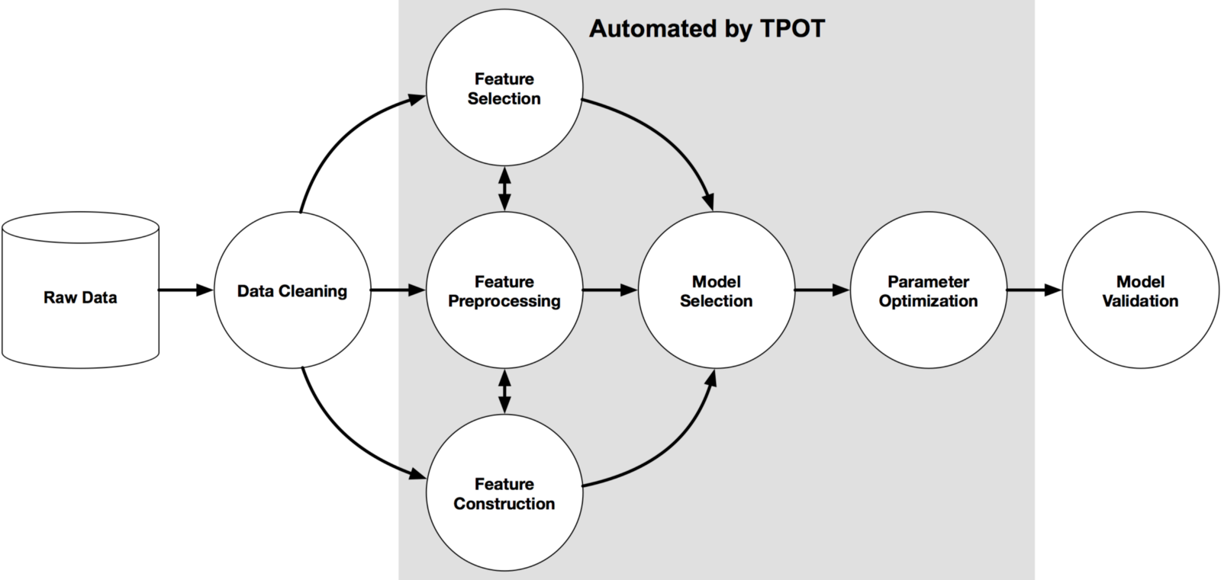
Tpot
TPOT is meant to be an assistant that gives you ideas on how to solve a particular machine learning problem by exploring pipeline configurations that you might have never considered, then leaves the fine-tuning to more constrained parameter tuning techniques such as grid search
TPOT will take a while to run on larger datasets, but it's important to realize why. With the default TPOT settings (100 generations with 100 population size), TPOT will evaluate 10,000 pipeline configurations before finishing
To put this number into context, think about a grid search of 10,000 hyperparameter combinations for a machine learning algorithm and how long that grid search will take. That is 10,000 model configurations to evaluate with 10-fold cross-validation, which means that roughly 100,000 models are fit and evaluated on the training data in one grid search
TPOT tries a pipeline, evaluates its performance, and randomly changes parts of the pipeline in search of better performing algorithms

Slide 32
Library Used
tpot import TPOTRegressor
Splitting the data into predictors and features
predictors = ['grade_C','grade_D','grade_E', 'grade_F','grade_G','total_rec_int’, 'total_pymnt_inv','funded_amnt_inv','sub_grade_B5', 'sub_grade_C5’,
‘sub_grade_C4','sub_grade_C3','sub_grade_B4','sub_grade_D5’]
response = ['int_rate’]
Instantiating, fitting, & scoring the TPOT classifier is like any other sklearn classifier
tpot = TPOTRegressor(generations=5, population_size=50, verbosity=2, config_dict = tpot_config)
tpot.fit(X_train, y_train)
print(tpot.score(X_test, y_test))
TPOT writes the optimized pipeline to an external python file
tpot.export(tpot_lendingClub_pipeline_lite.py)

Slide 33
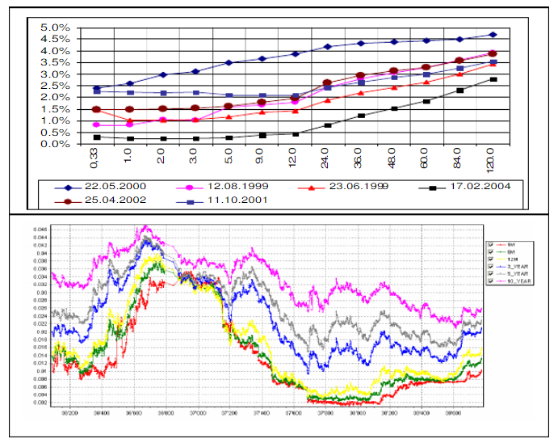
TEST CASE ANALYSIS
The selected test cases based on 6 criteria:
Annual Income: 2 test cases for high annual income, low income, mid-range annual income each
Term: Selected 5 case each for both given term i.e. 36, 60 months
Loan amount: 5 cases for high loan amount, low amount, mid-range loan amount each
Purpose: Took a different case for each of the 10 purposes
State: Selected a case for each of the 50 states
Enquiries in Last 6 months: Selected 2 test cases for lower number enquiries, 2 for higher enquiries, and 2 for mid number of enquiries

Slide 34







CALCULATIONS
MAPE for each Models:
Linear Regression: 8.54
Neural Network: 5.75
Random Forest: 3.4
T-POT: 11.72825015878589
AutoSKLearn: 12.38768 (No models are better than Random Model)
H2O: 6.55582879

Slide 35
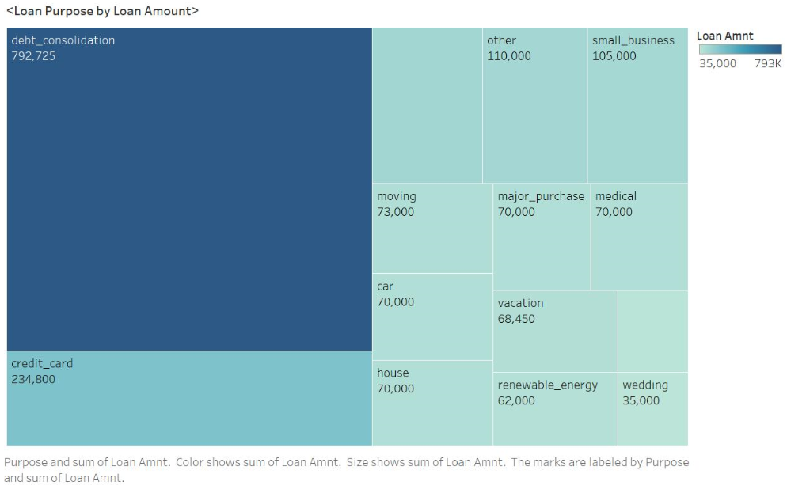
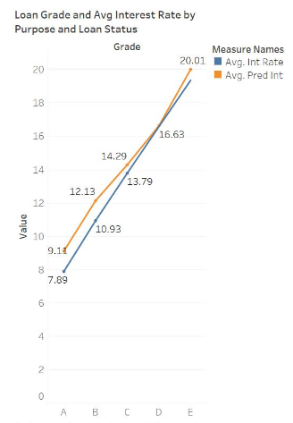
Visualizations – Using Tableau

Slide 36
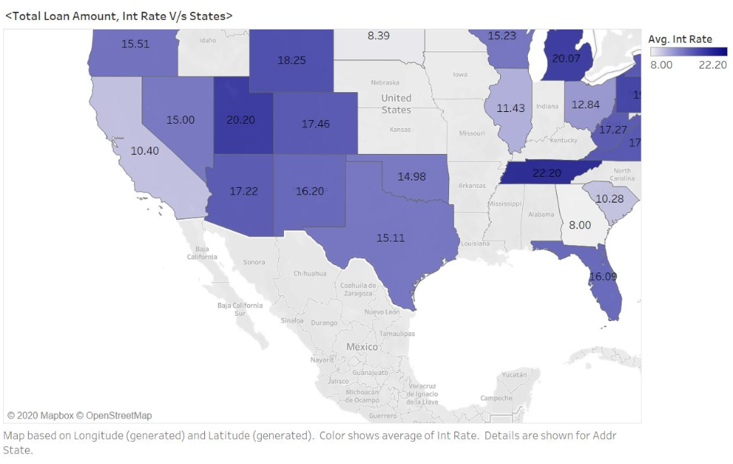
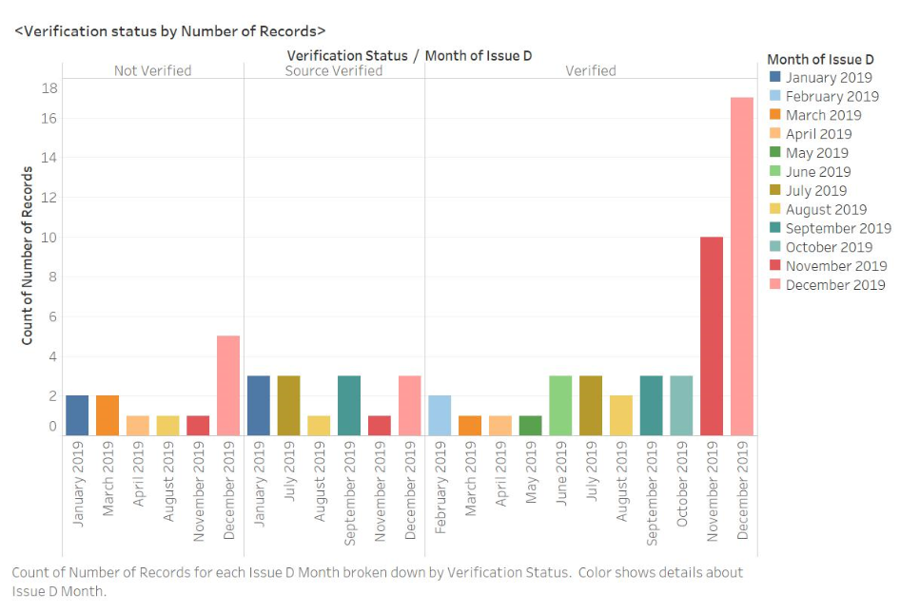

Slide 37
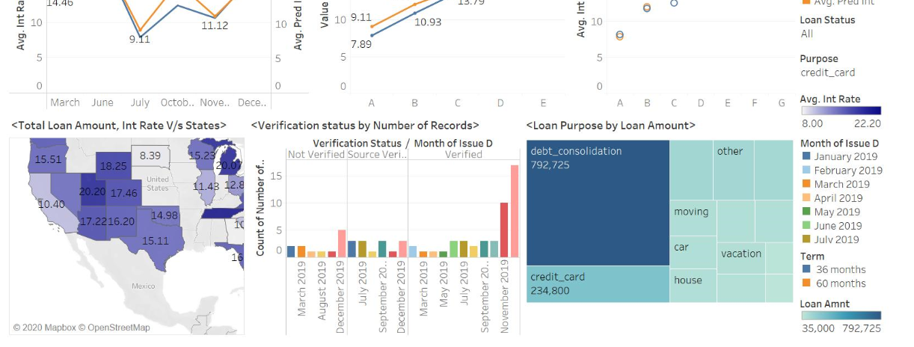
Tableau Dashboard

Slide 38
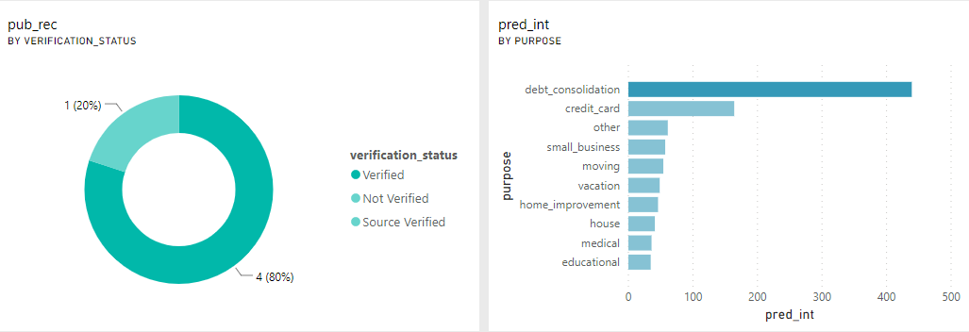
Visualizations – Using Power BI

Slide 39
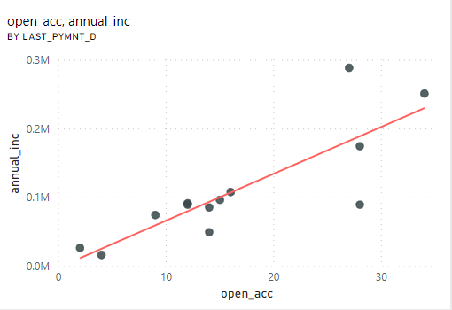
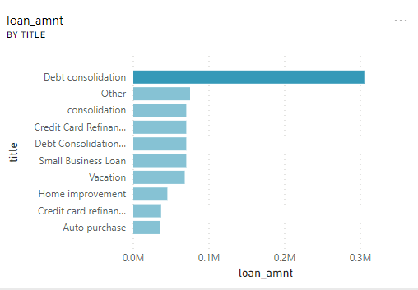
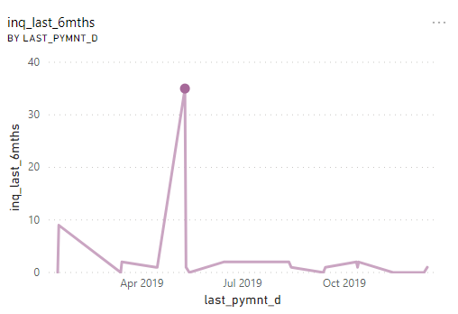

Slide 40
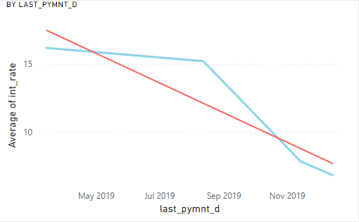
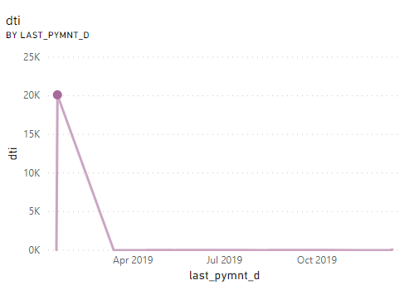
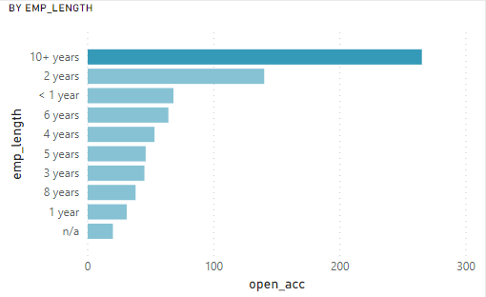

Slide 41
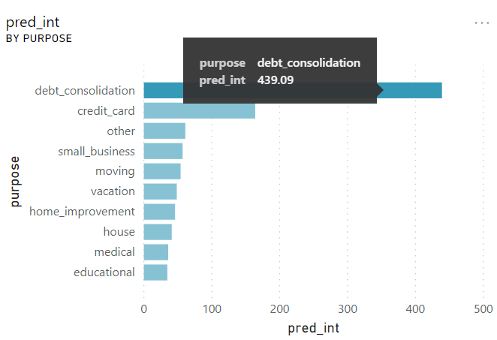
CONCLUSION
Amongst all the three models we can see that Random Forest Regressor gives us the best predictions.
Given, any test case including the ones carried out by our team, the predicted values can be seen satisfactory as compared to the actual data of interest rates provided by the lending club.
So, if we test, our model, against any scenario, be risk averse, risk taking or any other scenario, our model will give a satisfactory predicted estimate of the interest rate.
Also, it tells us about the most optimized ML Model that is Random Forest with a MAPE of 3.80
GITHUB Link:
https://github.com/akashmdubey/Lending-Club-Interest-Rate-Prediction-Using-Supervised-ML
Codelabs Link:
https://codelabs-preview.appspot.com/?file_id=1rYZCIi7hOFTiRhG1IEAnrO7JBcLSmFqHaxtiy4rvMDk#0

Slide 42

FUTURE WORK
We obtained a regression prediction threshold based on the training set, and simulated the strategy on the test set. Both sets comprise loans initiated within the same periods (2012-2015). We can check to see if the strategy generalizes to future loans by testing it on 2016-2018 loans that have finalized
The absence of a development set didn’t afford us much opportunity to tune the hyperparameters of our models, such as the number of decision trees to use in random forest models, and the number of hidden layers and neurons of each layer in neural network models. Having a small development set would enable us to tune some hyper-parameters quickly to help improve model performance metrics
We can also make better use of existing features in the Lending Club dataset. One example is loan description which the borrower enters at the time of loan application. Instead of dropping such freeform features, we can try applying some statistical natural language processing techniques
Finally, we notice that Lending Club also publishes declined loan datasets. We can add these declined loans as negative examples to our dataset, which helps further alleviate the class imbalance problem

Slide 43

THANK YOU

